Slide 1


MAP Lab
LAB 2 : Get To Know Basic GPIO & LED Blink
Kshitij Hemant Gurjar (SY M.Tech VLSI)
Prof. Y.M. Vaidya
Swapnil Phalke (SY M.Tech VLSI)
MAP Lab

Slide 2
AIM
Here we will explain how to initialize a GPIO (General-purpose input-output) pins of the TM4C123GH6PM microcontroller with the Tiva C series launchpad. In order to use the GPIO pin of a TM4C123G evaluation kit, we must first initialize the registers related to GPIO pins. At the end of the tutorial, the built-in LED of the TIVA board is blinked using the associated GPIO port with it.
LAB 1 Introduction to TM4C123
Kshitij Hemant Gurjar (SY M.Tech VLSI)
Prof. Y.M. Vaidya
Swapnil Phalke (SY M.Tech VLSI)
MAP Lab

Slide 3
Steps
Initialization of the main clock of the board
Enabling specific port registers of which the GPIO pins will be used
Initialization of GPIO port pins to either digital output or digital input .i.e. setting the direction pins
After that, the functionality of the port is selected if it is to be alternative or not (in this tutorial we are not using alternative functionality so skip it at this moment)
LAB 1 Introduction to TM4C123
Kshitij Hemant Gurjar (SY M.Tech VLSI)
Prof. Y.M. Vaidya
Swapnil Phalke (SY M.Tech VLSI)
MAP Lab

Slide 4
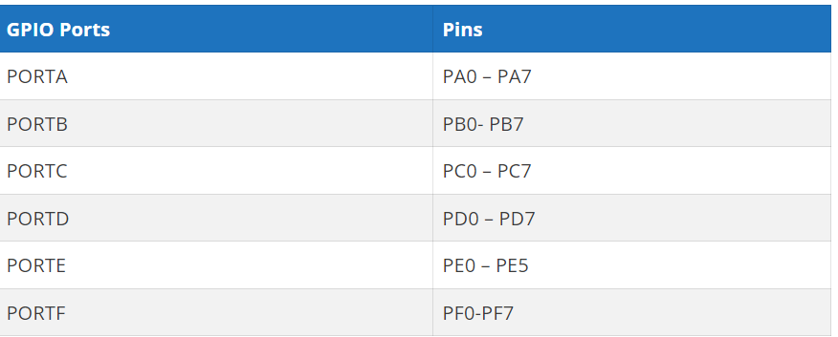
TM4C123GH6PM Microcontroller GPIO pins
TM4C123GH6PM belongs to the ARM Cortex M4 microcontroller series. It has six GPIO ports such as PORTA, PORTB, PORTC, PORTD, and PORTE. Each port has a different number of pins as given in this table.
LAB 1 Introduction to TM4C123
Kshitij Hemant Gurjar (SY M.Tech VLSI)
Prof. Y.M. Vaidya
Swapnil Phalke (SY M.Tech VLSI)
MAP Lab

Slide 5
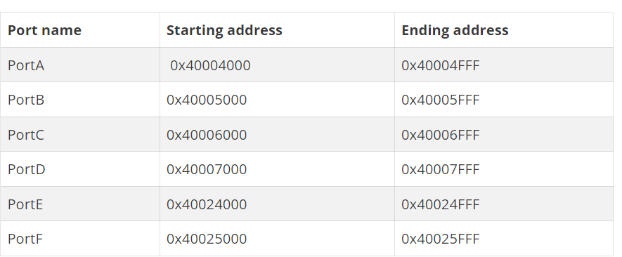
TM4C123GH6PM Microcontroller GPIO pins
All the address range of port A to port F are given in the table below. As you can see from this table, a total of 4K bytes of memory is allocated for each PORT. The reseason for this larger amount of memory for each port is due to many functions and special functions registers associated with each port of TM4C123G.
LAB 1 Introduction to TM4C123
Kshitij Hemant Gurjar (SY M.Tech VLSI)
Prof. Y.M. Vaidya
Swapnil Phalke (SY M.Tech VLSI)
MAP Lab

Slide 6
Revise Steps
Initialization of the main clock of the board
Enabling specific port registers of which the GPIO pins will be used
Initialization of GPIO port pins to either digital output or digital input .i.e. setting the direction pins
After that, the functionality of the port is selected if it is to be alternative or not (in this tutorial we are not using alternative functionality so skip it at this moment)
LAB 1 Introduction to TM4C123
few additional steps might be required. For instance, some of the GPIO pins are assigned special functionality by default, and to configure them as general-purpose input-output pins, we need to unlock or unmask the pin. It is possible to configure a GPIO pin as an alternative functionality multiplexing,
Kshitij Hemant Gurjar (SY M.Tech VLSI)
Prof. Y.M. Vaidya
Swapnil Phalke (SY M.Tech VLSI)
MAP Lab

Slide 7
Basic steps for TM4C123GH6PM launchpad configuration as a GPIO are listed below
1 - Clock configuration 2 - Data control configuration 3 - Mode control configuration 4 - Pad control configuration
Kshitij Hemant Gurjar (SY M.Tech VLSI)
Prof. Y.M. Vaidya
Swapnil Phalke (SY M.Tech VLSI)
MAP Lab

Slide 8
GPIO Pins Clock Enable Register
The first step in GPIO configuration is to enable the clock for a particular peripheral you want to enable. A particular port can be enabled by setting an appropriate bit field for the required GPIO port in the RCGCGPIO register.
RCGCGPIO Register is on pg. No. 340 of datasheet
RCGCGPIO |= 0x01 //Enable clock for PORTA
RCGCGPIO |= 0x02 //Enable clock for PORTB
RCGCGPIO |= 0x04 //Enable clock for PORTC
RCGCGPIO |= 0x08 //Enable clock for PORTD
RCGCGPIO |= 0x01 //Enable clock for PORTE
RCGCGPIO |= 0x02 //Enable clock for PORTF
Kshitij Hemant Gurjar (SY M.Tech VLSI)
Prof. Y.M. Vaidya
Swapnil Phalke (SY M.Tech VLSI)
MAP Lab

Slide 9
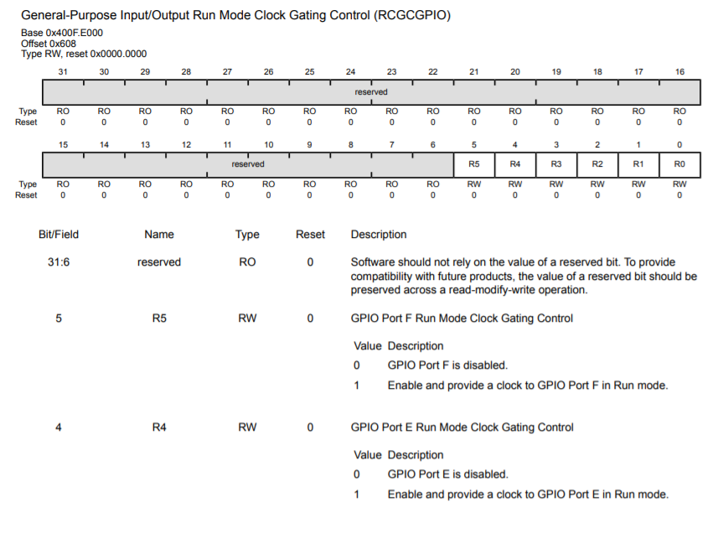
Kshitij Hemant Gurjar (SY M.Tech VLSI)
Prof. Y.M. Vaidya
Swapnil Phalke (SY M.Tech VLSI)
MAP Lab

Slide 10
TM4C123G GPIODATA Register
The GPIO port pins of TM4C123G are multiplexed with different peripherals such as digital I/O, PWM, serial communication, etc. But each pin can be used for only one functionality at a time. GPIODEN register is used to enable GPIO pins as digital input-output pins.
When the port pin is configured as GPIO pins, the GPIODATA register is used to read and write data on the registers. If the pin is configured as a digital output pin, the data written to the GPIODATA register reflects on the corresponding output pin.
Kshitij Hemant Gurjar (SY M.Tech VLSI)
Prof. Y.M. Vaidya
Swapnil Phalke (SY M.Tech VLSI)
MAP Lab

Slide 11
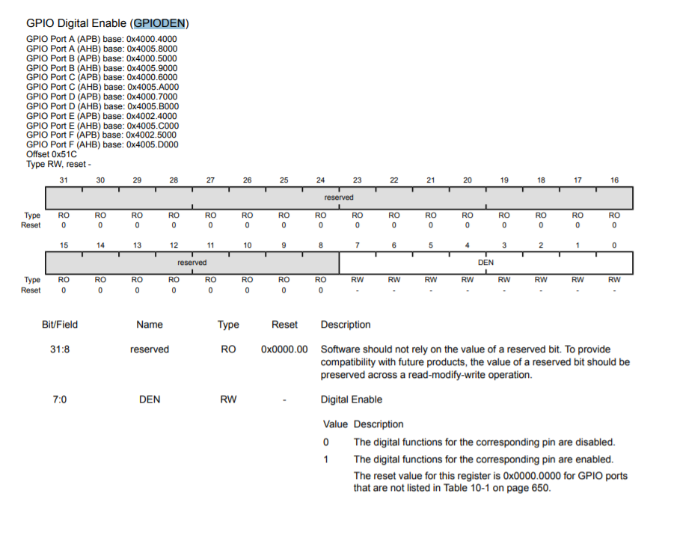
Pg 683
Kshitij Hemant Gurjar (SY M.Tech VLSI)
Prof. Y.M. Vaidya
Swapnil Phalke (SY M.Tech VLSI)
MAP Lab

Slide 12
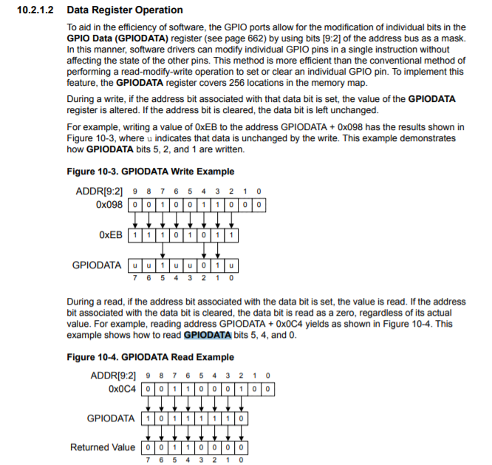
Pg 654
Kshitij Hemant Gurjar (SY M.Tech VLSI)
Prof. Y.M. Vaidya
Swapnil Phalke (SY M.Tech VLSI)
MAP Lab

Slide 13
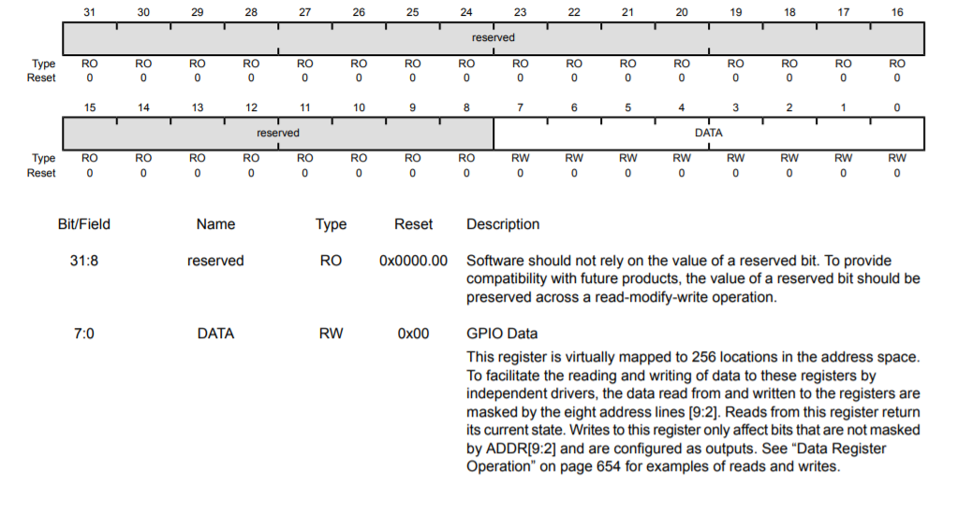
Pg 662
Kshitij Hemant Gurjar (SY M.Tech VLSI)
Prof. Y.M. Vaidya
Swapnil Phalke (SY M.Tech VLSI)
MAP Lab

Slide 14
TM4C123G GPIODIR Direction Control Register
A GPIODIR register decides, which pins of the PORT will be configured either as a digital input or a digital output. The individual configuration capability of each GPIO is applicable to other registers of the GPIO port pins.
If we want to enable a pin of a port as digital input-output the corresponding bit on the GPIODIR register should be set or reset. If we want to configure a particular pin of any port as a digital input pin, the corresponding e data direction bit should be cleared. Similarly, if we want to configure a particular pin of any port as a digital output pin, the corresponding data direction bit should be set to one.
Kshitij Hemant Gurjar (SY M.Tech VLSI)
Prof. Y.M. Vaidya
Swapnil Phalke (SY M.Tech VLSI)
MAP Lab

Slide 15
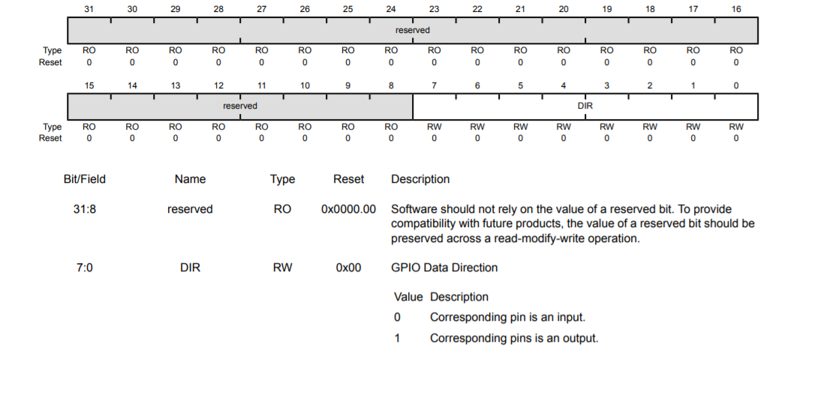
Pg 663
Kshitij Hemant Gurjar (SY M.Tech VLSI)
Prof. Y.M. Vaidya
Swapnil Phalke (SY M.Tech VLSI)
MAP Lab

Slide 16
GPIO PORTF base address = 0x4002 5000
GPIODEN Register offset address = 0x51c // page number 682 TM4C123GH6PM datasheet
physical address = 0x40025000+0x51C = 0x4002551C
Base address of PORTF = 0x40025000
Offset address of GPIODIR = 0x400 // // page number 663 TM4C123GH6PM datasheet
GPIODIR Physical address = 0x40025000+0x400 = 0x40025400
#define SYSCTL_RCGCGPIO_R (*(( volatile unsigned long *)0x400FE608 ) )
#define GPIO_PORTF_DATA_R (*(( volatile unsigned long *)0x40025038 ) )
#define GPIO_PORTF_DIR_R (*(( volatile unsigned long *)0x40025400 ) )
#define GPIO_PORTF_DEN_R (*(( volatile unsigned long *)0x4002551C ) )
int main ( void )
{
SYSCTL_RCGCGPIO_R |= 0x20; // Enable clock for PORTF
GPIO_PORTF_DEN_R = 0x0E; // Enable PORTF Pin1, 2 and 3 as a digital pins
GPIO_PORTF_DIR_R = 0x0E; // Configure ORTF Pin1, 2 and 3 digital output pins
while (1)
{
GPIO_PORTF_DATA_R |= 0x02; // turn on red LED
}
}
PORTF Base Address = 0x40025000
GPIODATA Registe offset address = is 0x000
GPIODATA Physical address = 0x40025000+0x608 = 0x40025000
Kshitij Hemant Gurjar (SY M.Tech VLSI)
Prof. Y.M. Vaidya
Swapnil Phalke (SY M.Tech VLSI)
MAP Lab

Slide 17
#include "TM4C123.h" // header files contains memory addresses listing
int main ( void )
{
SYSCTL->RCGCGPIO|= 0x20;
GPIOF->DIR = 0x02;
GPIOF->DEN = 0x02;
while (1){
GPIOF->DATA = 0x02; // turn on red LED
}
}
Kshitij Hemant Gurjar (SY M.Tech VLSI)
Prof. Y.M. Vaidya
Swapnil Phalke (SY M.Tech VLSI)
MAP Lab

Slide 18
int main(void)
{
SysCtlClockSet(SYSCTL_SYSDIV_5|SYSCTL_USE_PLL|SYSCTL_XTAL_16MHZ|SYSCTL_OSC_MAIN);
SysCtlPeripheralEnable(SYSCTL_PERIPH_GPIOF);
GPIOPinTypeGPIOOutput(GPIO_PORTF_BASE,GPIO_PIN_1|GPIO_PIN_2|GPIO_PIN_3);
while(1)
{
GPIOPinWrite(GPIO_PORTF_BASE,GPIO_PIN_1|GPIO_PIN_2|GPIO_PIN_3,0x02);
SysCtlDelay(5000000);
GPIOPinWrite(GPIO_PORTF_BASE,GPIO_PIN_1|GPIO_PIN_2|GPIO_PIN_3,0x04);
SysCtlDelay(5000000);
GPIOPinWrite(GPIO_PORTF_BASE,GPIO_PIN_1|GPIO_PIN_2|GPIO_PIN_3,0x08);
SysCtlDelay(5000000);
}
}
Kshitij Hemant Gurjar (SY M.Tech VLSI)
Prof. Y.M. Vaidya
Swapnil Phalke (SY M.Tech VLSI)
MAP Lab

Slide 19
Assignment 1 :
What is Embedded C Programming? How is Embedded C different from C language?
What is ISR?
What is Void Pointer in Embedded C and why is it used?
Why do we use the volatile keyword?
How will you use a variable defined in source file1 inside source file2?
LAB 1 Introduction to TM4C123
Kshitij Hemant Gurjar (SY M.Tech VLSI)
Prof. Y.M. Vaidya
Swapnil Phalke (SY M.Tech VLSI)
MAP Lab

Slide 20
Assignment 2 :
Go through all registers of GPIO
Read following functions:SysCtlPeripheralEnable,GPIOPinWrite,SysCtlDelay,SysCtlClockSet,GPIOPinTypeGPIOOutput
Compute XOR from 1 to n
LAB 1 Introduction to TM4C123
Input : n = 6
Output : 7
// 1 ^ 2 ^ 3 ^ 4 ^ 5 ^ 6 = 7
Input : n = 7
Output : 0
// 1 ^ 2 ^ 3 ^ 4 ^ 5 ^ 6 ^ 7 = 0
Kshitij Hemant Gurjar (SY M.Tech VLSI)
Prof. Y.M. Vaidya
Swapnil Phalke (SY M.Tech VLSI)
MAP Lab

